Slide 1
Injustice Under Law: Perpetuating and Criminalizing Poverty Through the Courts
The 59th Henry J. Miller Lecture —
Judge Lisa Foster (Ret.)
March 2, 2017
Georgia State University College of Law

Slide 2

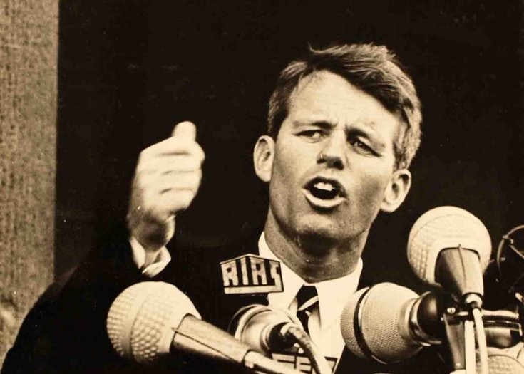
“Do minorities or people who speak our language imperfectly . . . or those who are poor really receive the same protection before the courts as the rest of our citizens? All too often, they do not.”
        -Robert Kennedy - 1962

Slide 3
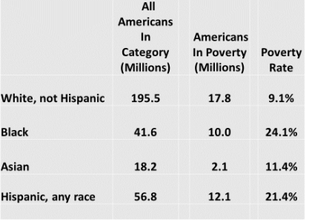
Poverty and Race
 | Total Population (in millions) | Americans in Poverty | Poverty Rate
White | 195.5 | 17.8 | 9.1%
Black | 41.6 | 10.0 | 24.1%
Asian | 18.2 | 2.1 | 11.4%
Hispanic | 56.8 | 12.1 | 21.4%

Slide 4
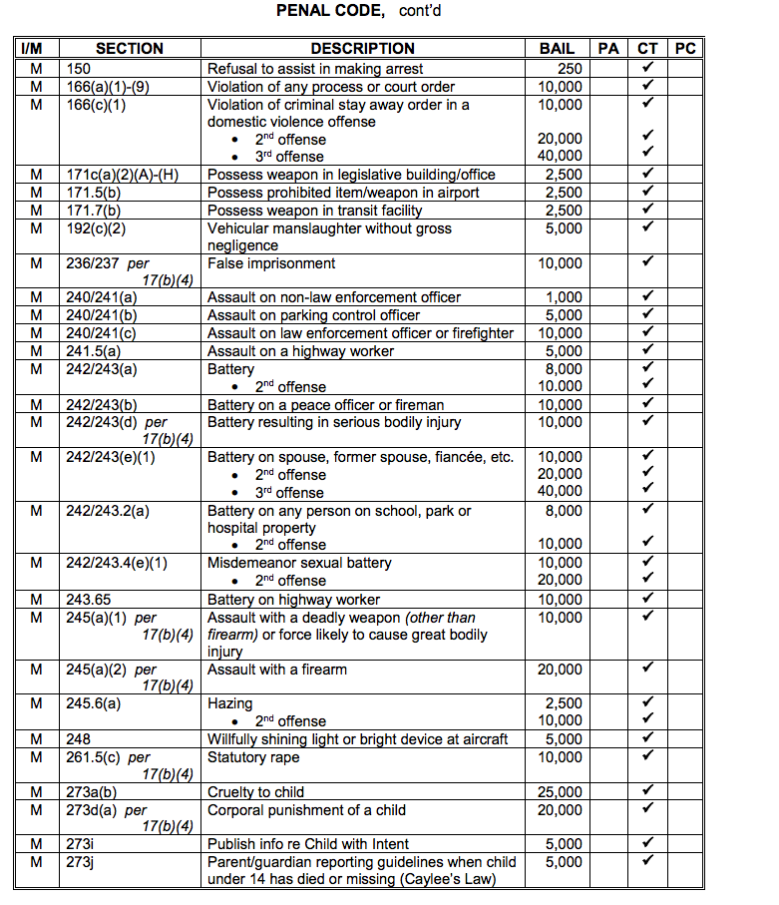
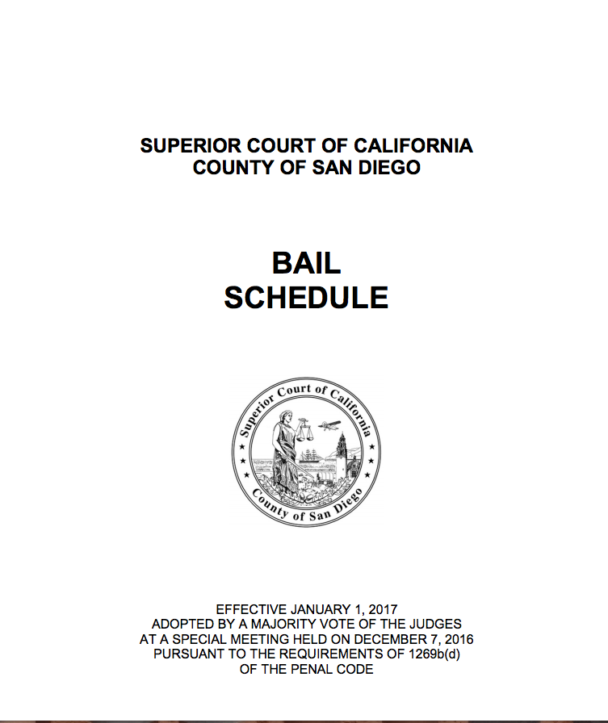
San Diego County Bail Schedule

Slide 5
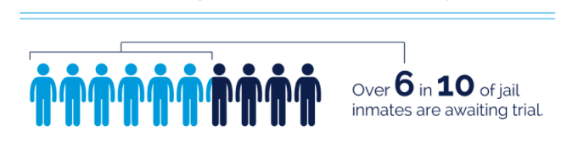
Source: Pretrial Justice Institute
Percentage of People in Jail Awaiting Trial
1986 40%
1996 50%
2016 63%

Slide 6
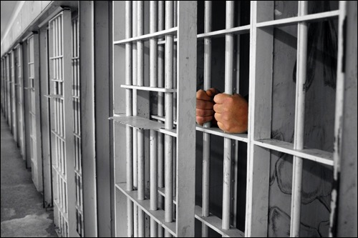
People detained pretrial are - -
Four times more likely to be sentenced to jail
  Sentences are three times longer
Three times more likely to be sentenced to prison
  Sentences are twice as long

Slide 7
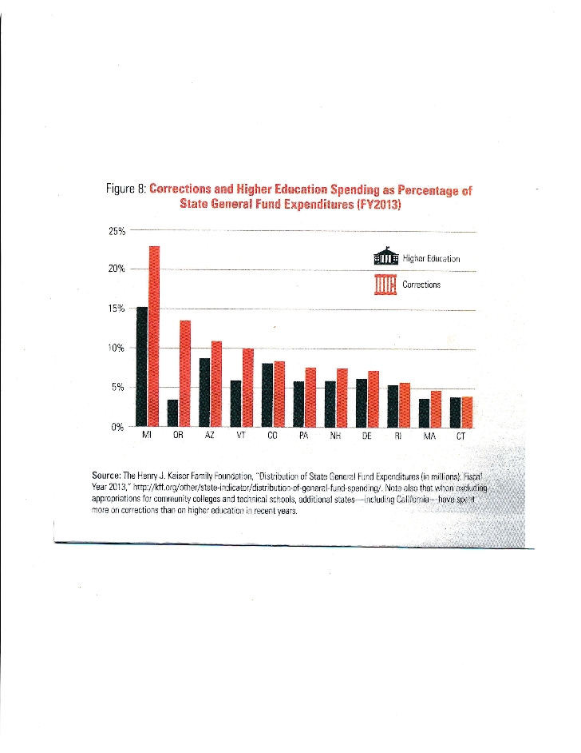

Slide 8
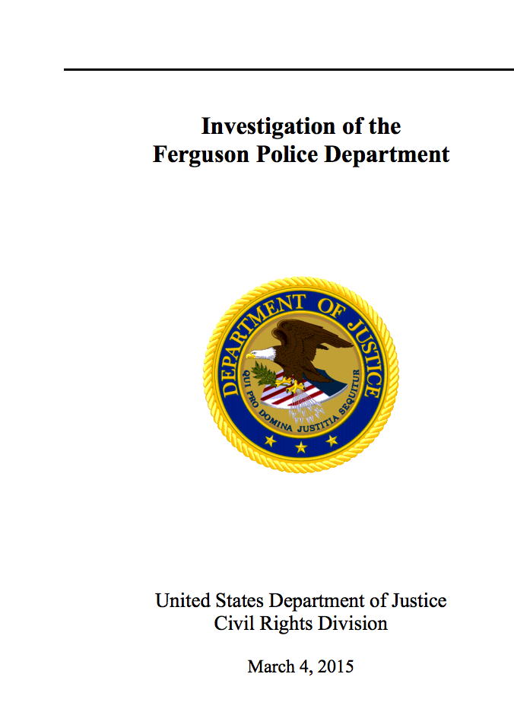
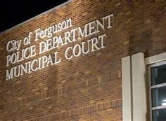
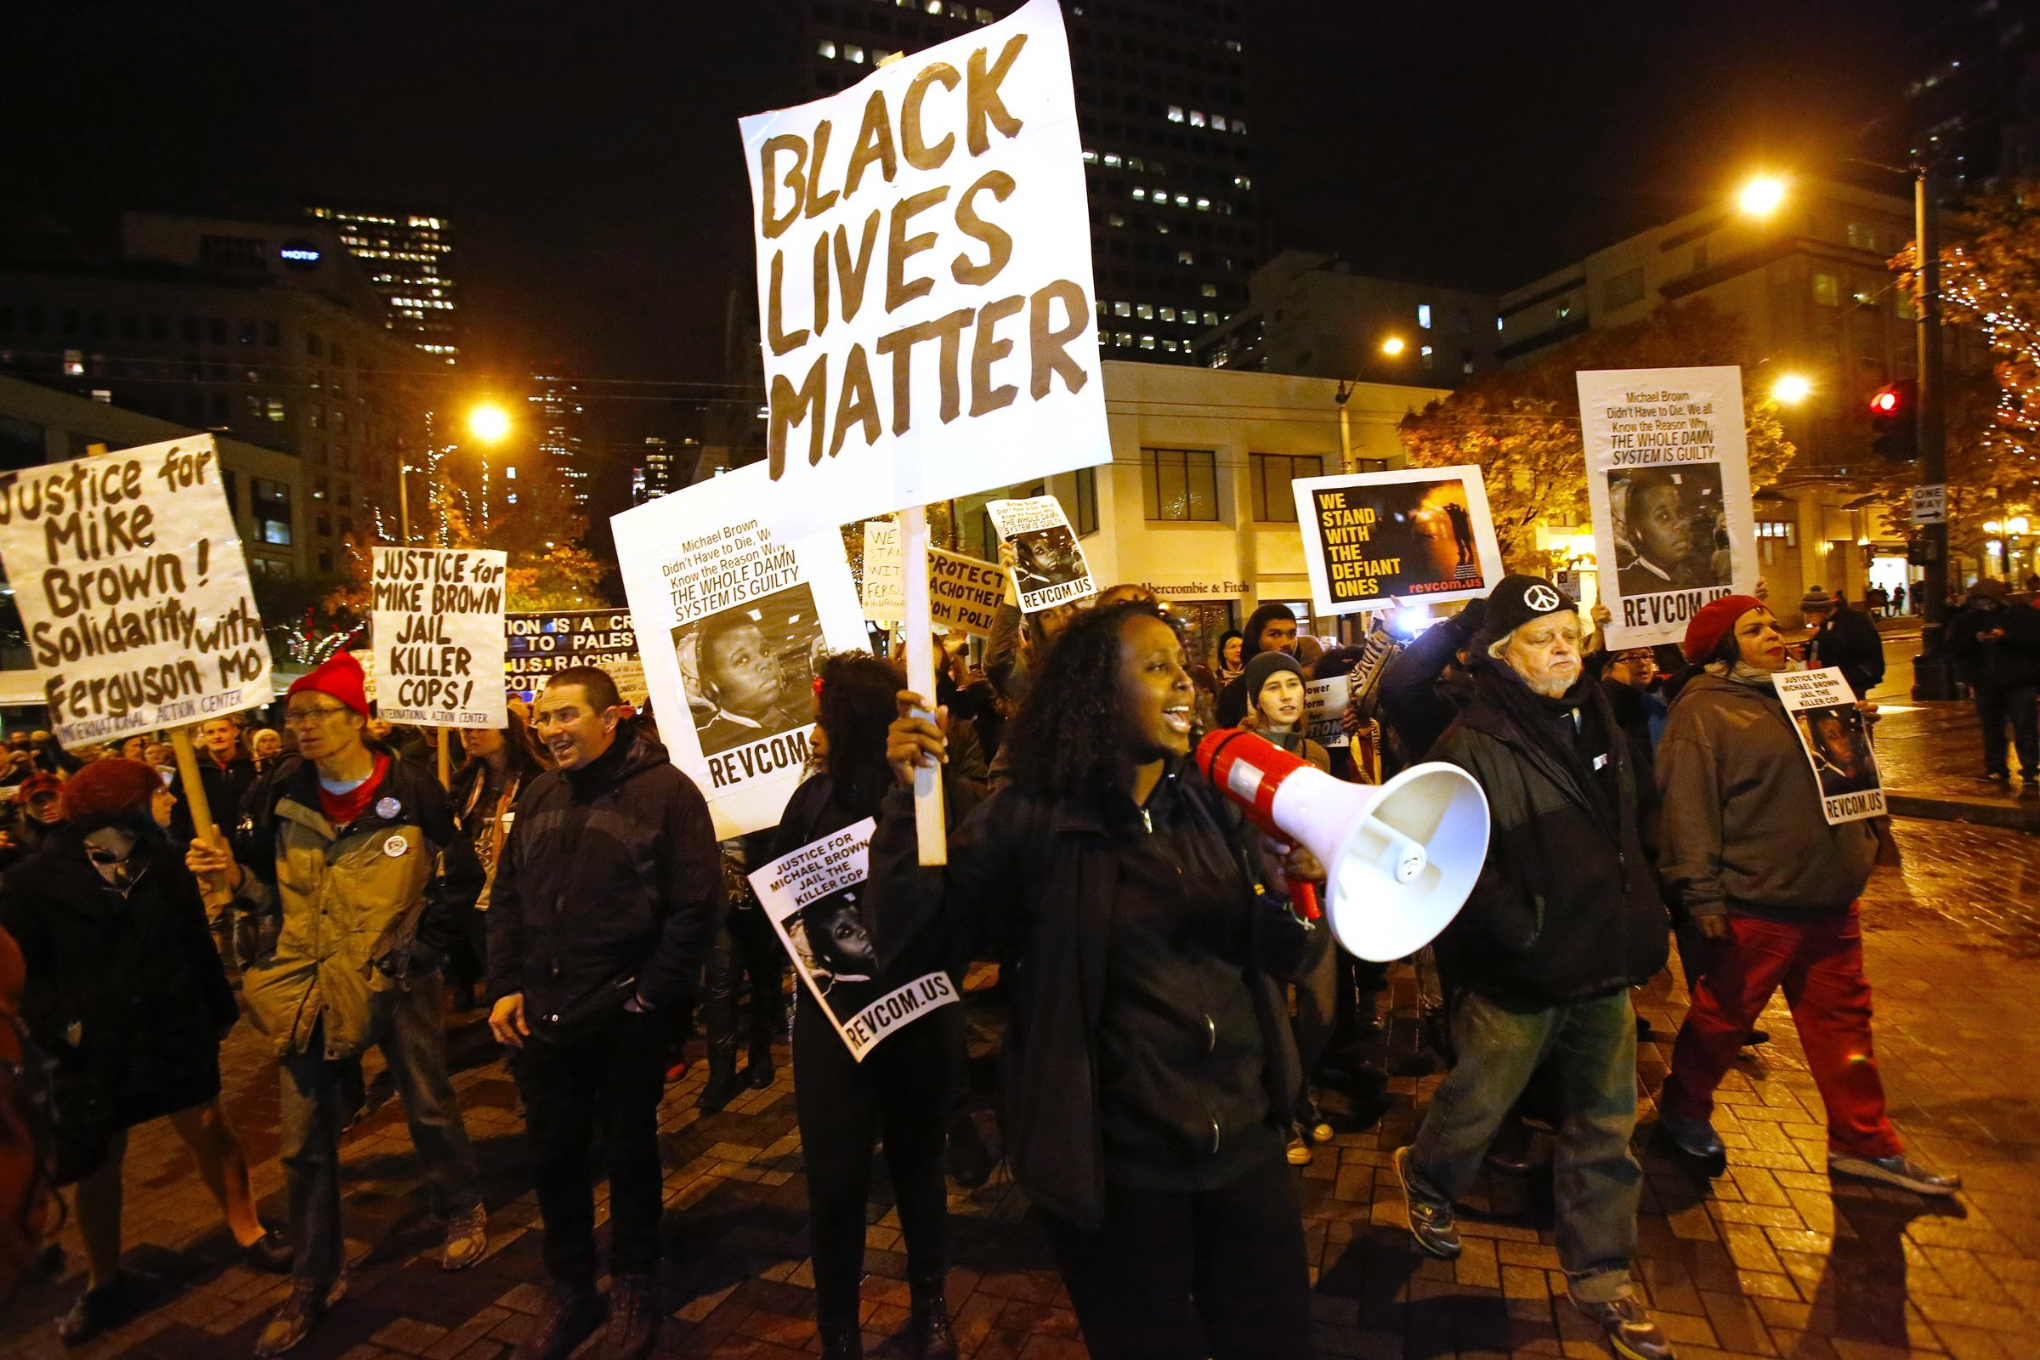

Slide 9
Bearden v. Georgia, 461 U.S. 660, 672-73 (1983)
“If the probationer could not pay despite sufficient bona fide efforts to acquire the resources to do so, the court must consider alternative measures of punishment other than imprisonment. . . .To do otherwise would deprive the probationer of his conditional freedom simply because, through no fault of his own, he cannot pay the fine. Such a deprivation would be contrary to the fundamental fairness required by the Fourteenth Amendment.”

Slide 10
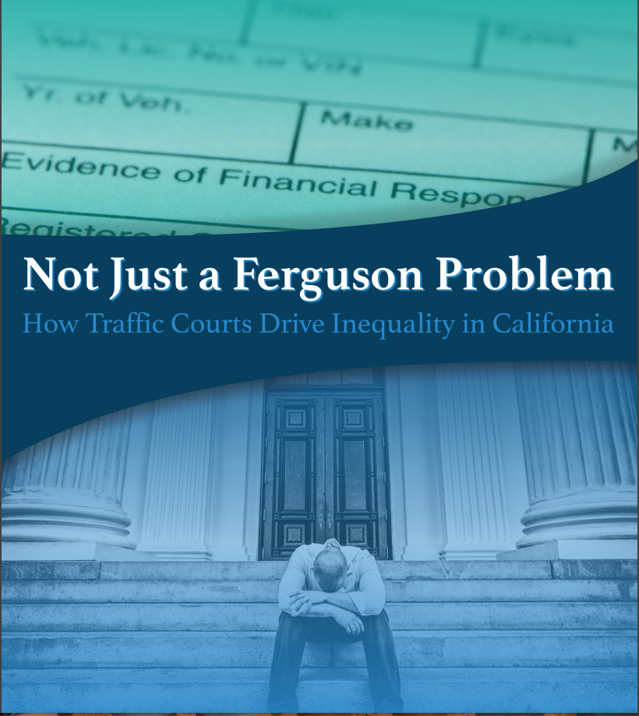
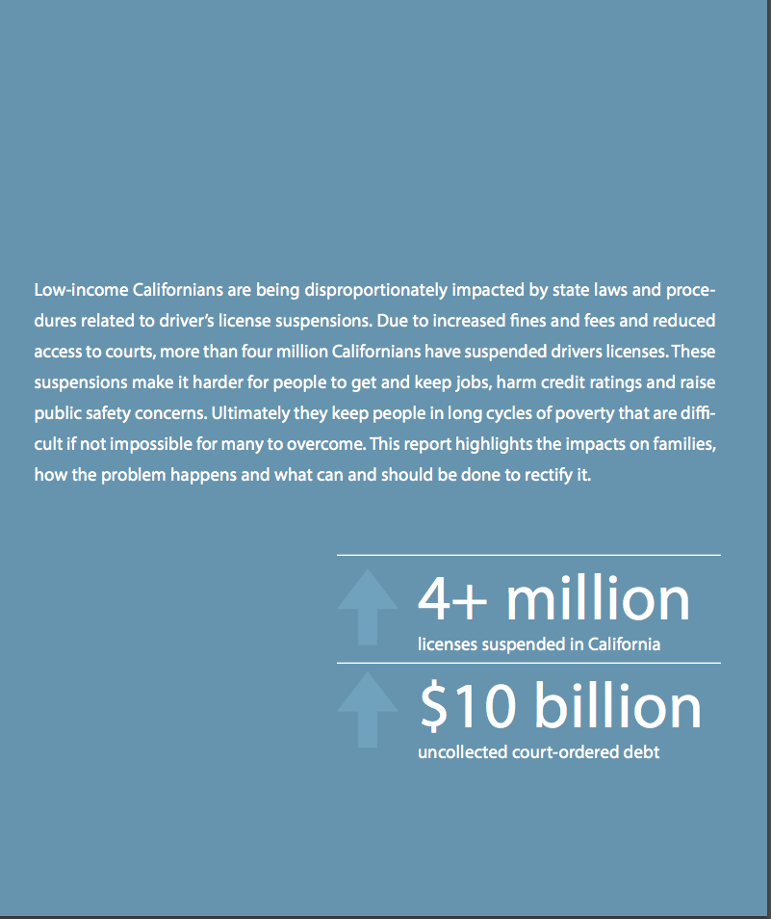

Slide 11
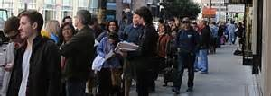
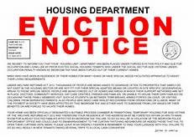
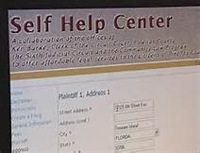
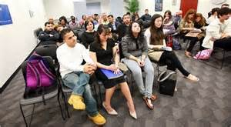
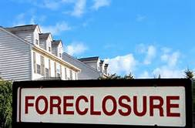
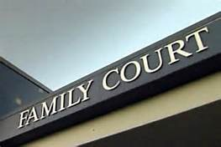

Slide 12
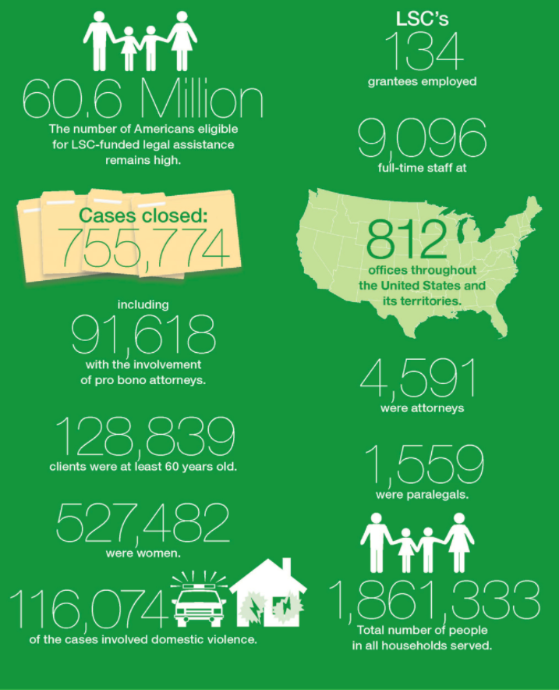
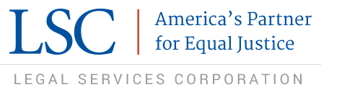
2015 Appropriation:
$375 million

Slide 13
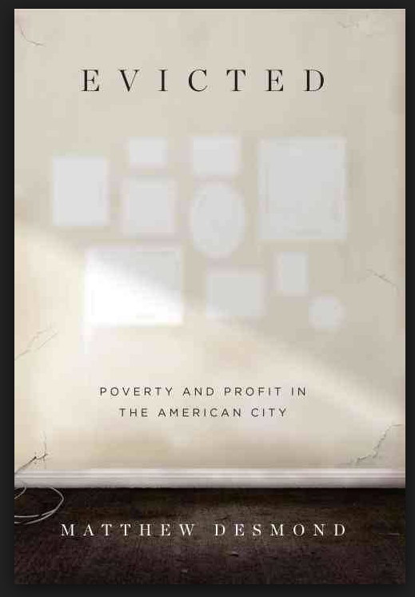
“Eviction does not simply drop poor families into a dark valley, a trying yet relatively brief detour on life’s journey. It fundamentally redirects their way, casting them not a different and more difficult path.”
“Eviction is a cause, not just a condition of poverty.”

Slide 14
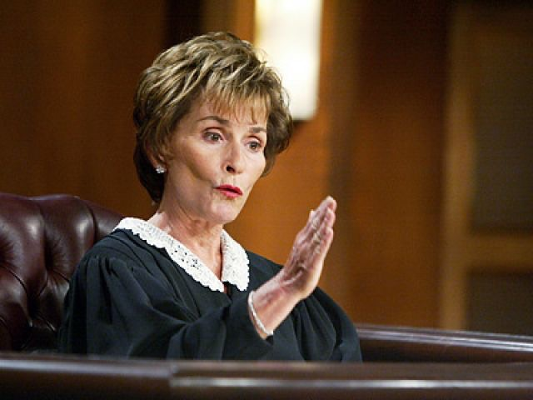
“Lawyers also appear to help courts follow their own rules.”
                - Professor Rebecca Sandefur,
                University of Illinois

Slide 15

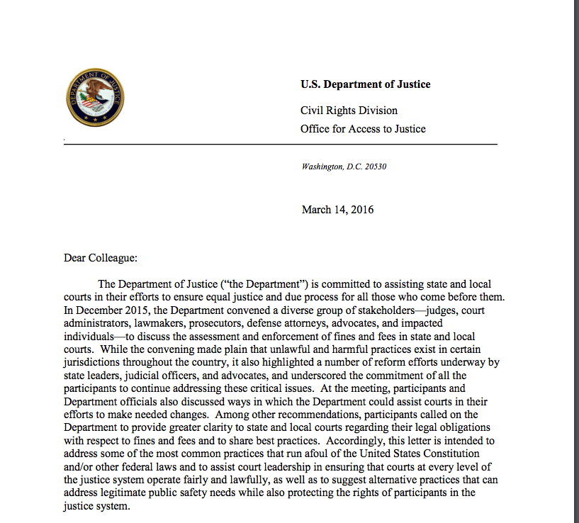

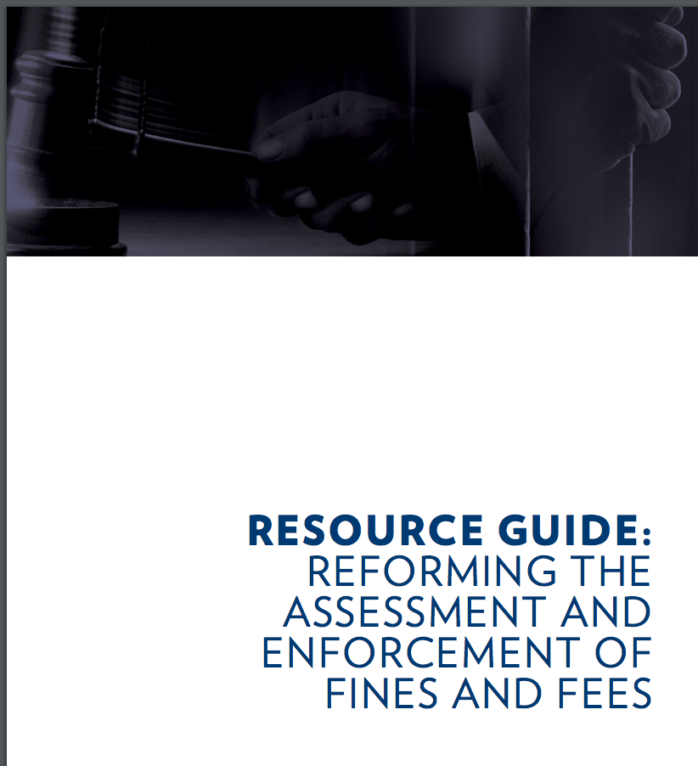

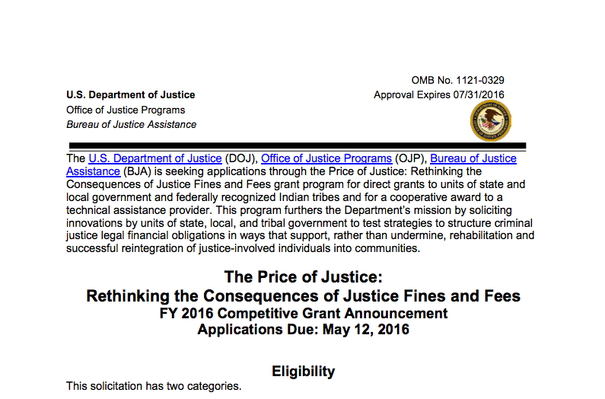

Slide 16

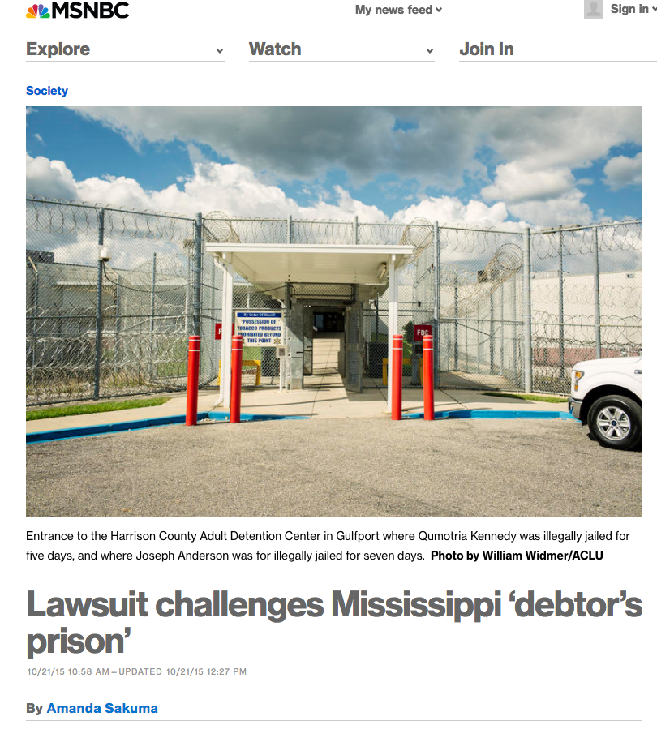
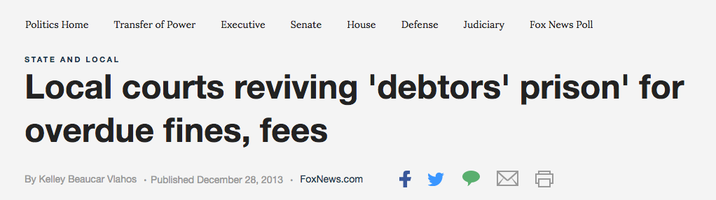

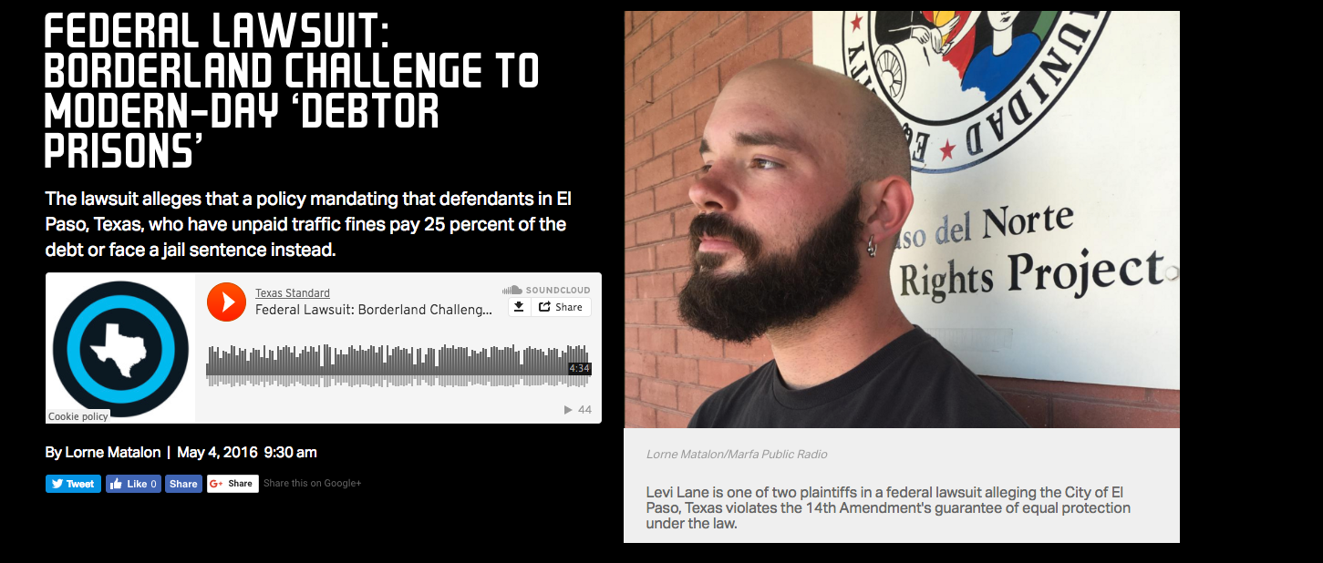

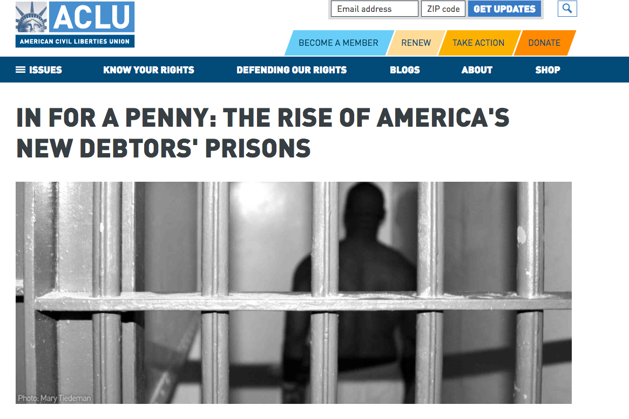

Slide 17
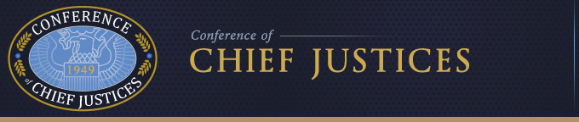
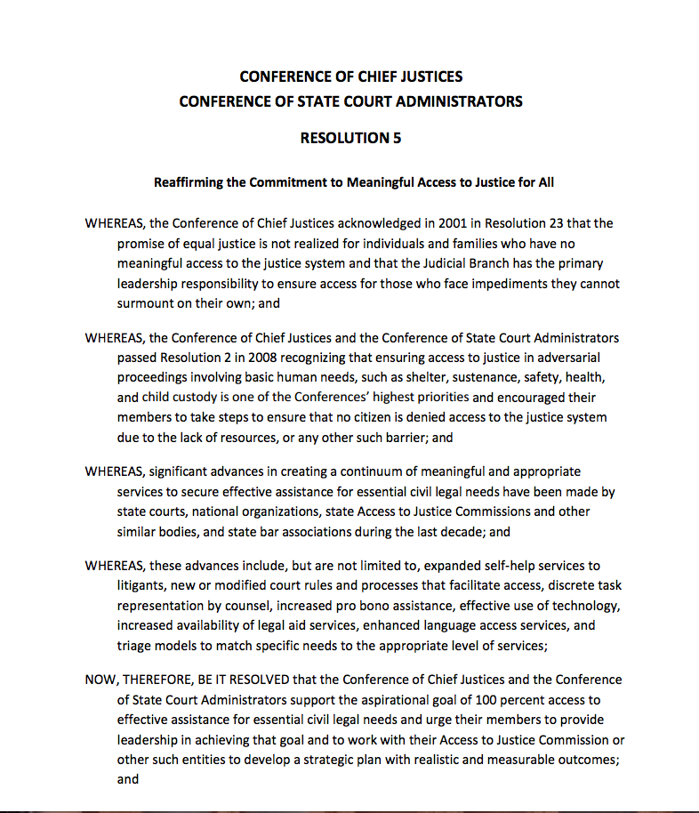
“Now, therefore be it resolved,
that the Conference of Chief Justices
and the Conference of State Court
Administrators support the aspirational goal of
100 percent access to effective assistance
for essential civil legal needs . . . “

Slide 18
Poverty and Justice — toward a new legal theory
“There can be no equal justice where the kind of trial a man gets depends on the amount of money he has.” Griffin v. Illinois, 351 U.S. 12, 19 (1956)
Indigent defendant entitled to counsel on first direct appeal. Douglas v. California, 372 U.S. 353 (1963)
Indigent entitled to free transcript. Roberts v. LaVallee, 389 U.S. 40 (1967)
State cannot convert a fine imposed under a fine-only statute to a jail term solely because the defendant is indigent and cannot avoid to pay. Tate v. Short, 401 U.S. 395 (1971)

Slide 19
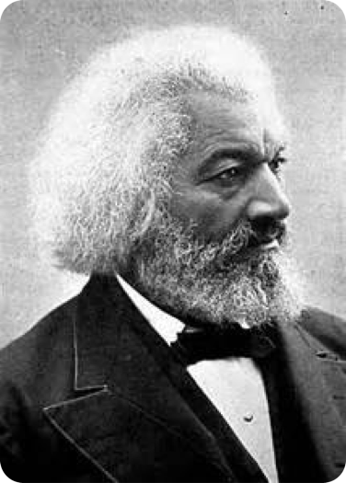
“. . . where justice is denied, where poverty is enforced, where ignorance prevails, and where any one class is made to feel that society is an organized conspiracy to oppress, rob and degrade them, neither persons nor property will be safe.”
Frederick Douglass

